Slide 1
Welcome to the infinibox
Enter present mode to play infinibox
euclidean edition

Slide 5
Welcome to the Infinibox
euclidean edition

Slide 9
Welcome to the Infinibox
Non-euclidean edition

Slide 13
Welcome to Infinibox
Teehee

Slide 17
Welcome to Box
Non-euclidean education

Slide 18

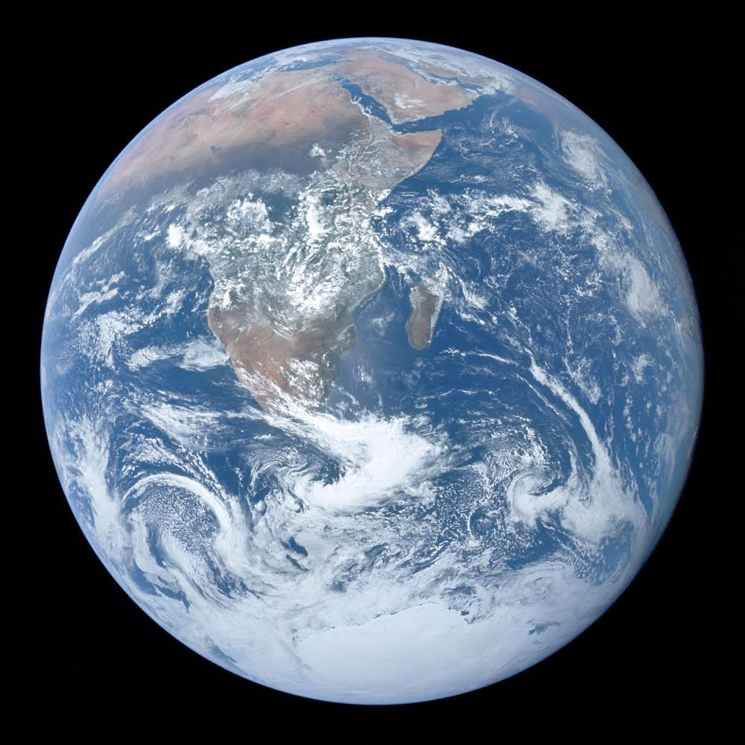

Slide 21
Welcome to the Oxes’ Boxes
Non-education edition

Slide 23
GL1tCh
GL1tCh

Slide 25
Welcome to the Oxes Boxen’
Non-education edition

Slide 27
H31p
H31p

Slide 29
Welcome to the Chaos Box
Non-existent education

Slide 31
H31p m3
H31p m3

Slide 32
AHHHHHHHHHHHHHH STOP SCROLLING

Slide 33
Welcome to the chaos Boxen’
N0n-3x1st3nt 3ducat10n

Slide 35
RUN
RUN

Slide 37
Welcome to the chaos Boxen’s house
RUN

Slide 39
RUN
RUN
RUN
RUN
RUN
RUN
RUN
RUN
RUN
RUN
RUN
RUN
RUN
RUN
RUN
RUN
RUN
RUN
RUN
RUN
RUN
RUN
RUN
RUN
RUN
RUN
RUN
RUN
RUN
RUN
RUN
RUN
RUN
RUN

Slide 41
Welcome to the imminent nuclear meltdown
escape while you still can

Slide 43
RUN
RUN
RUN
RUN
RUN
RUN
RUN
RUN
RUN
RUN
RUN
RUN
RUN
RUN
RUN
RUN
RUN
RUN
RUN
RUN
RUN
RUN
RUN
RUN
RUN
RUN
RUN
RUN
RUN
RUN
RUN
RUN
RUN
RUN

Slide 45
… — …
ITS TOO LATE, CHERNOBLE 2

Slide 47
The end is nyan cat
RUN
RUN
RUN
RUN
RUN
RUN
RUN
RUN
RUN
RUN
RUN
RUN
RUN
RUN
RUN
RUN
RUN
RUN
RUN
RUN
RUN
RUN
RUN
RUN
RUN
RUN
RUN
RUN
RUN
RUN
RUN
RUN
RUN
RUN

Slide 64
Goodbye…

Slide 70
It’s going of early??? AHHHHHH!!!!!!!!!!!!!!

Slide 71
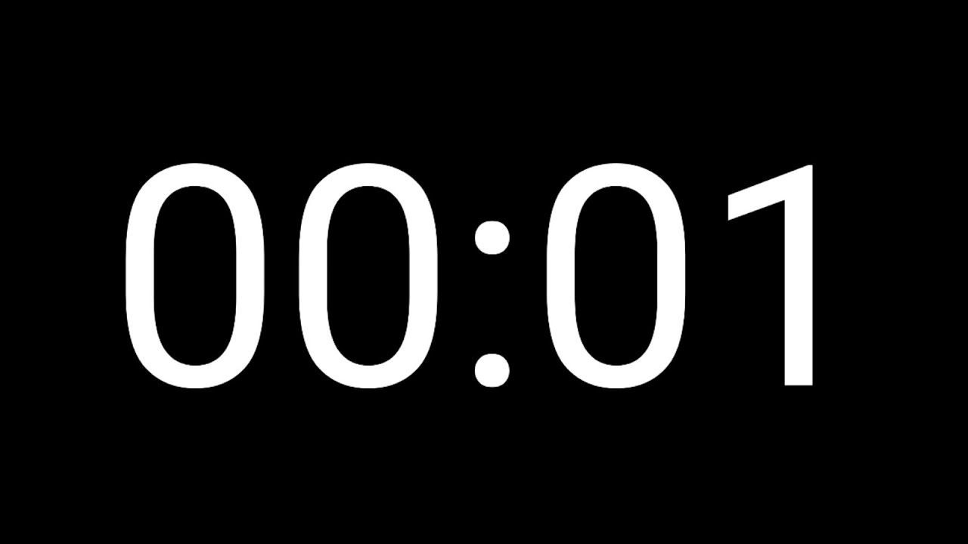

Slide 72
No more cube, everything is gone, you wake up in a dark room rethinking your actions, could you save it all?
Press space to continue

Slide 73
Someone comes to you carrying a small necklace with an hourglass in his hand “I need you to save this world, millions died to the meltdown, america was destroyed”
Press space to continue

Slide 74
“But you can reverse it, (holds out the necklace) this is a time turner, by spinning it, you can go back in time, saving millions” he hands you the time turner what will you do?
Press space to continue

Slide 75
Do you want to go back in time to save millions of lives, or watch the chaos ensue on the world after america being destroyed.
Press space to use the time turner. Press here to watch the chaos ensue, and stealing the time turner.
Press here to use the time turner to go to the future For safety.

Slide 76
You use the time turner, sending you back in time to before you triggered the nuclear meltdown in the cube, in the cube, use left to move left on the cube and right to move right.
Press HERE to continue

Slide 77
You have misclicked, click anywhere to go back

Slide 78
TIME CHEATER
You were told to press anywhere to go back but you ignored it, so you were restrained and sent to azkaban. Or you weren’t in present mode and disappeared along with putin. TAKE THESE SPOILERS the cube is a person and if you destroy him, you die too

Slide 84
You have misclicked, click anywhere to go back

Slide 85
You have misclicked, click anywhere to go back

Slide 86
Good ending
You use the time turner to go forward in time after pressing the button, the man lets you keep the time turner and invites you to the ministry of magic. Putin disappears because the box was destroyed, and the spirit inside it turned into your friend john who had suddenly disappeared when you were 10

Slide 87
Good cliffhanger
Kim jong un realizes the power of non Euclidean space in a Euclidean world, and he is now researching it…
More coming soon…

Slide 88
You have misclicked, click anywhere to go back

Slide 89
You have misclicked, click anywhere to go back

Slide 96
You have misclicked, click anywhere to go back

Slide 97
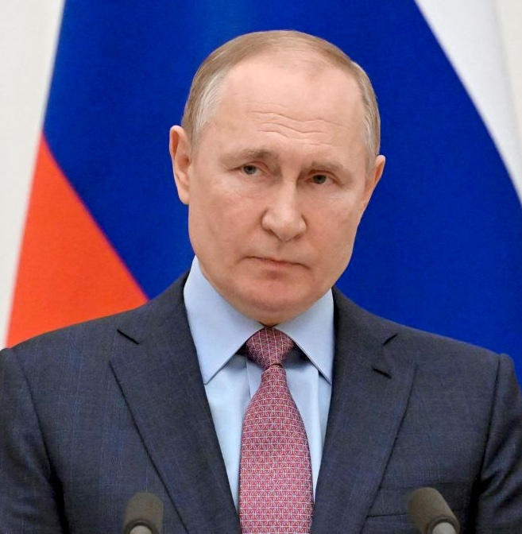
Almost safe!!
Just press the button to save the world from destruction.
SAVE AMERICA
DO NOT PRESS IT
SAVE ME!!!! It’s been a long time.

Slide 98
Are you sure
Putin offers peace, as long as you go all the way to the right and ignite the cube again.

Slide 99
ATTACK
the russian army has come to sabotage you, if you continue, you may die

Slide 100
Welcome to the infinibox
a little bit further

Slide 104
Welcome to the Infinibox
almost there!!!

Slide 108
Welcome to the Infinibox
You can save me!

Slide 112
Welcome to Infinibox
hey, its me john

Slide 116
Welcome to Box
Non-euclidean education

Slide 120
Welcome to the Oxes’ Boxes
Non-education edition

Slide 122
GL1tCh
GL1tCh

Slide 124
Welcome to the Oxes Boxen’
Non-education edition

Slide 126
H31p
H31p

Slide 128
Welcome to the Chaos Box
Non-existent education

Slide 130
H31p m3
H31p m3

Slide 131
AHHHHHHHHHHHHHH STOP SCROLLING GO BACK TO THE START

Slide 132
Welcome to the chaos Boxen’
N0n-3x1st3nt 3ducat10n

Slide 134
FOR

Slide 136
Welcome to the chaos Boxen’s house
GO BACK FAST

Slide 138
freedom

Slide 140
Welcome to the imminent nuclear meltdown
escape while you still can

Slide 142
RUN
RUN
RUN
RUN
RUN
RUN
RUN
RUN
RUN
RUN
RUN
RUN
RUN
RUN
RUN
RUN
RUN
RUN
RUN
RUN
RUN
RUN
RUN
RUN
RUN
RUN
RUN
RUN
RUN
RUN
RUN
RUN
RUN
RUN

Slide 144
… — …
ITS TOO LATE, CHERNOBLE 2

Slide 146
The end is nyan cat
RUN
RUN
RUN
RUN
RUN
RUN
RUN
RUN
RUN
RUN
RUN
RUN
RUN
RUN
RUN
RUN
RUN
RUN
RUN
RUN
RUN
RUN
RUN
RUN
RUN
RUN
RUN
RUN
RUN
RUN
RUN
RUN
RUN
RUN

Slide 148
You monster
NOW YOU DIE WITH IT
Goodbye, Bad ending. America stays destroyed, it also destroys from greenland to Cuba , and radiating all the way to the UK. Russia teams up with North Korea and takes over the world. People decide to do a mass suicide to end the reign. With 1000 citizens left, Putin is assassinated by Kim jong un, and the 100 people left decide to do a mass restart of the world.

Slide 149
You have misclicked, click anywhere to go back

Slide 150
You have misclicked, click anywhere to go back

Slide 151
You have misclicked, click anywhere to go back

Slide 152
You have misclicked, click anywhere to go back

Slide 174
Putin ending
You stole the time turner and went back in time, got some connections in Russia and changing your name to Vladimir Putin and you block your past self from saving America and explode along with the cube. Leaving the world to Kim Jong Un. And when he takes over the world, the magical world imprisons him and frees the remaining citizens and repair all of the explosion.

Slide 185
You have misclicked, click anywhere to go back

Slide 186
You have misclicked, click anywhere to go back

Slide 187
Welcome to the future
Where north korea rules all, cubes are a new primary weapon
Press space to skip further in time

Slide 188
Welcome to the future
Humanity has reset, you are the smartest person in the world
Press space to stay in this time

Slide 189
The reset ending
You share all past events with the people, causing computers and all modern technology to be WAY BETTER. And you are the ruler of all people.
What will you do next… in infiniplanet reset ending

Slide 190
You have misclicked, click anywhere to go back

Slide 191
You have misclicked, click anywhere to go back

Slide 193
You steal the time turner
You go back in time and think about returning it, to return it, restart the whole slideshow And give it another chance. press space to continue

Slide 194
Are you sure
You decide you should return the time turner but take over Russia, but you feel a horrible feeling growing in you. ARE YOU SURE, THIS WILL ULTIMATELY DESTROY YOU AND PROBABLY MAKE THE CUBE TRAP YOU.

Slide 195
STOP
IF YOU CONTINUE JOHN WILL DIE

Slide 196
Major spoilers AHEAD
STOP GOING

Slide 197
If you don’t want the entire story spoiled
STOP, RESTART, otherwise, continue

Slide 198
SPOILERS
in the good ending the cube disappears and you take over Russia, and become corrupt, or maybe it was the one where john decided to destroy the cube. Or maybe Putin is killed by the cube.

Slide 199
THIS IS NOT AN ENDING
NO ENDING HERE, stop, for your own good

Slide 200
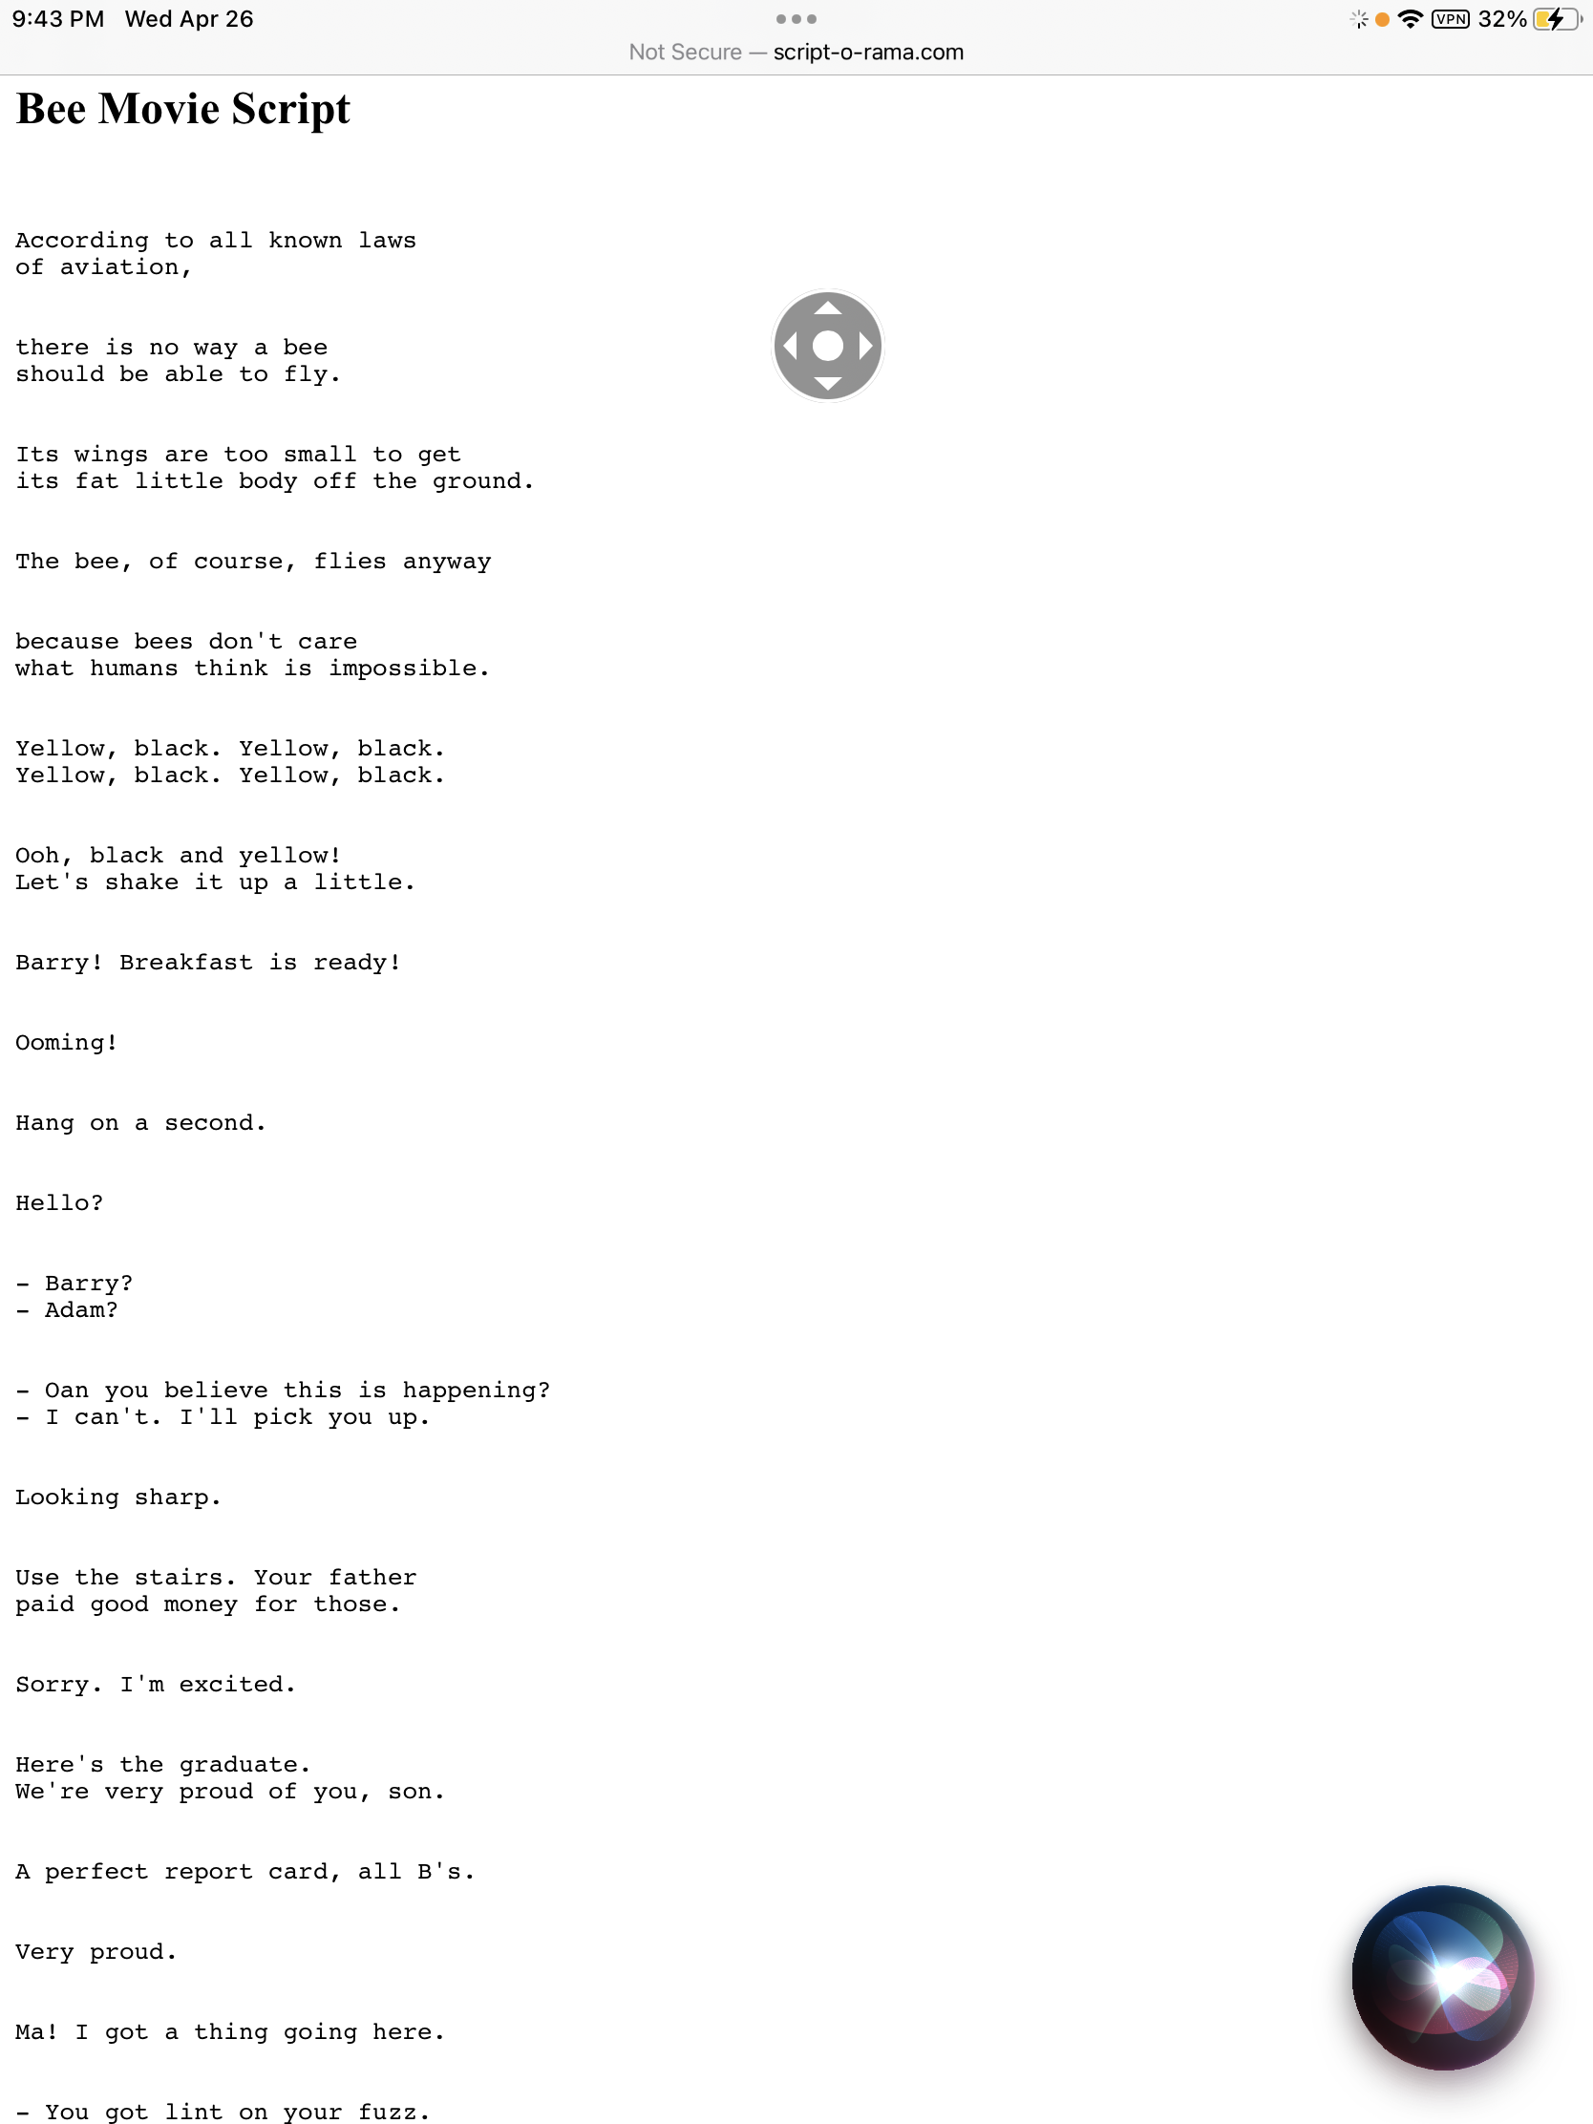
Text = link

Slide 274
Final ending
You escape the cube through slide phasing in and out of the back rooms not stopping the explosion and relocating it to Putin house, killing him. And all of earth, causing nukes on the moon to go off, causing the sun to explode, causing all explosives in the solar system to be ignited, exploding the milky way, exploding andromeda and all of the universe. No cliffhanger for u.

